Slide 1


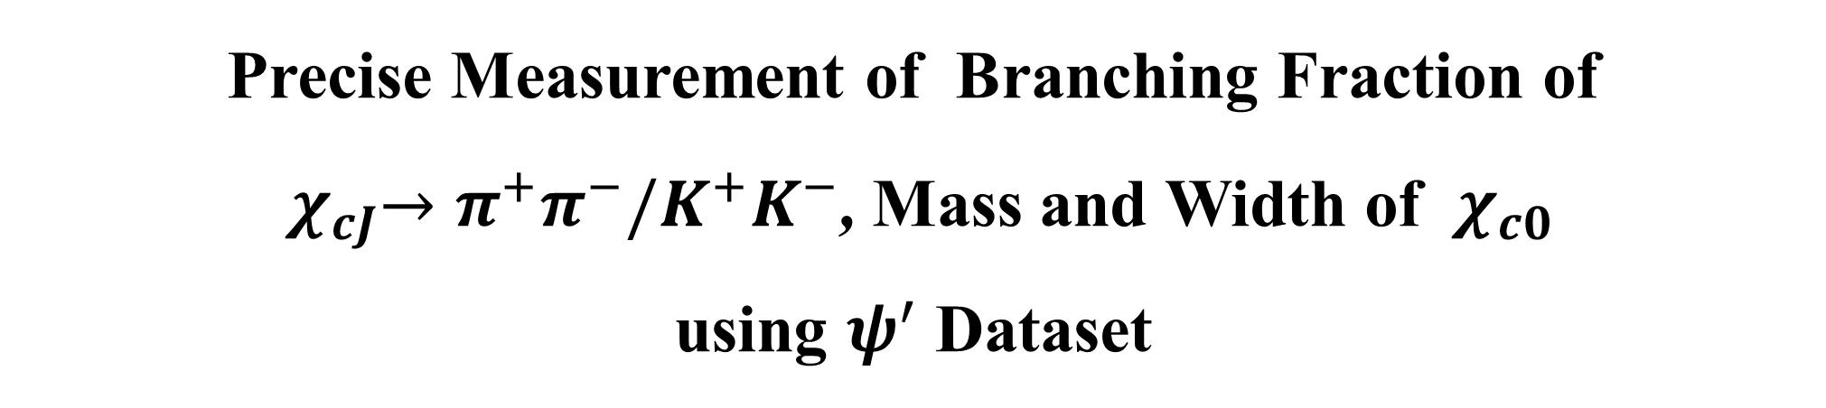
Precise Measurement of Branching Fraction of
${ χ}_{cJ}→π^{+}π^{−}/K^{+}K^{−}\text{,}$Mass and Width of ${ χ}_{c0}$
using $ψ^{′}$ Dataset
Fanrui Zeng, Hang Zhou, Zhentian Sun, Zhiqing Liu
Shandong University
2023（类）粲偶素物理研讨会
October 29 , 2023

Slide 2
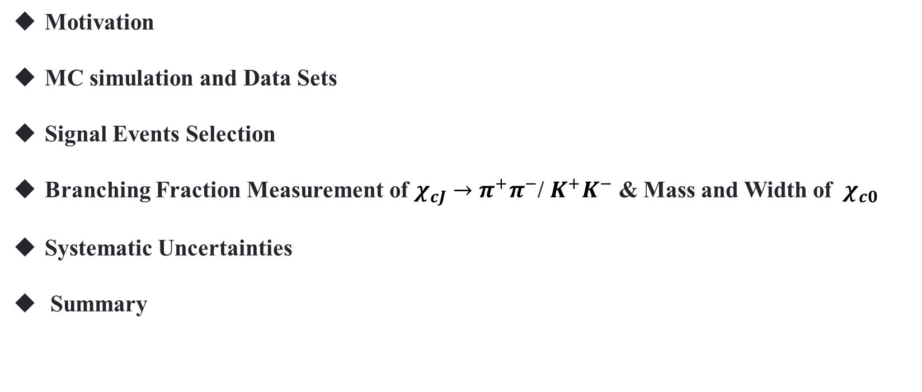
Outline
Motivation
MC simulation and Data Sets
Signal Events Selection
Branching Fraction Measurement of $χ_{cJ}→π^{+}π^{−}$/ $K^{+}K^{−}$ & Mass and Width of ${ χ}_{c0}$
Systematic Uncertainties
Summary

Slide 3
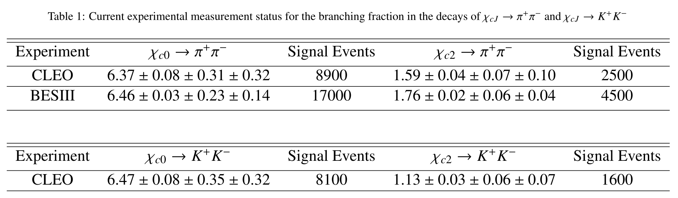
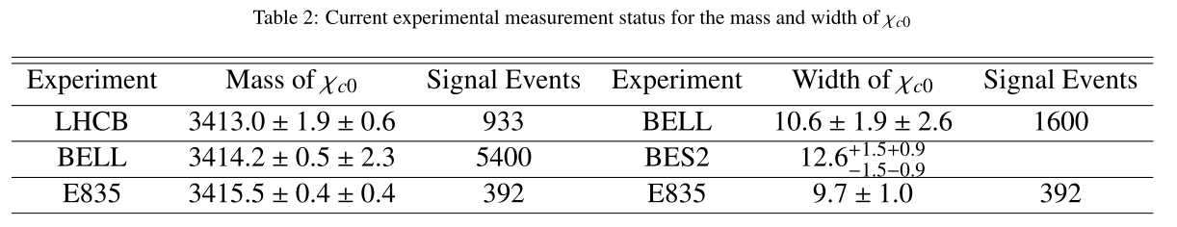
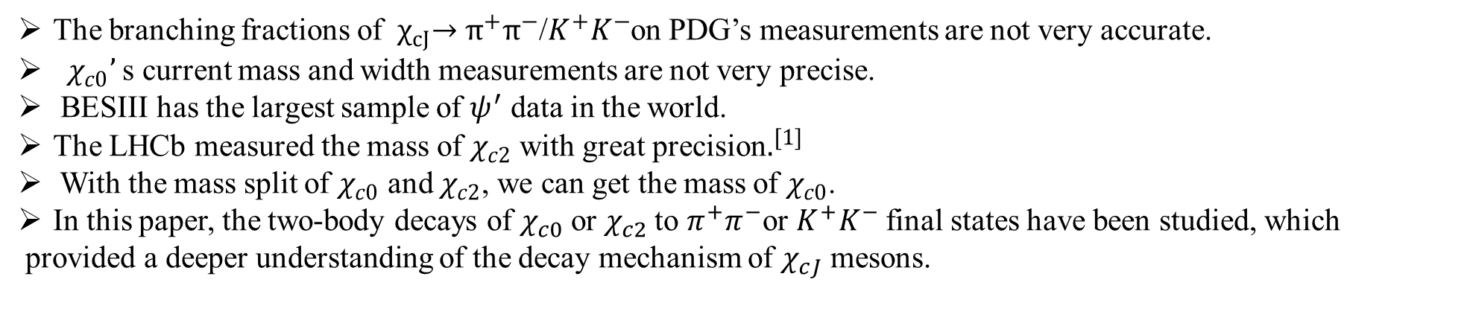

Motivation
Precise measurement
$$ψ(3686)$$
𝝍(𝟑𝟔𝟖𝟔)
$$χ_{cJ}$$
𝝌_𝒄𝑱
$$π^{+}/K^{+}$$
𝝅^+/𝑲^+
$$π^{−}{/K}^{−}$$
𝝅^− 〖/𝑲〗^−
$$γ$$
𝛾
BF of${ χ}_{cJ}→π^{+}π^{−}$/$K^{+}K^{−}$
Mass and width of${ χ}_{c0}$
The branching fractions of ${ χ}_{cJ}→π^{+}π^{−}$/$K^{+}K^{−}$on PDG’s measurements are not very accurate.
${ χ}_{c0}’$s current mass and width measurements are not very precise.
BESIII has the largest sample of $ψ^{′}$ data in the world.
The LHCb measured the mass of $χ_{c2}$ with great precision$.^{[1]}$
With the mass split of $χ_{c0}$ and $χ_{c2}$, we can get the mass of $χ_{c0}$.
In this paper, the two-body decays of $χ_{c0}$ or $χ_{c2}$to $π^{+}π^{−}$or $K^{+}K^{−}$final states have been studied, which
provided a deeper understanding of the decay mechanism of $χ_{cJ}$ mesons.
[1]DOI: 10.1103/PhysRevLett.119.221801

Slide 4
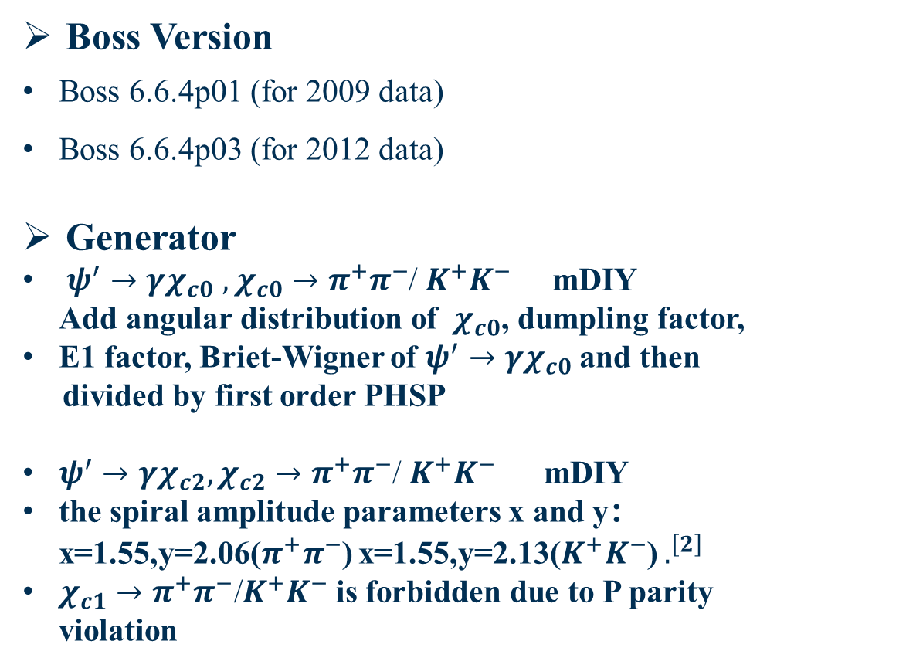
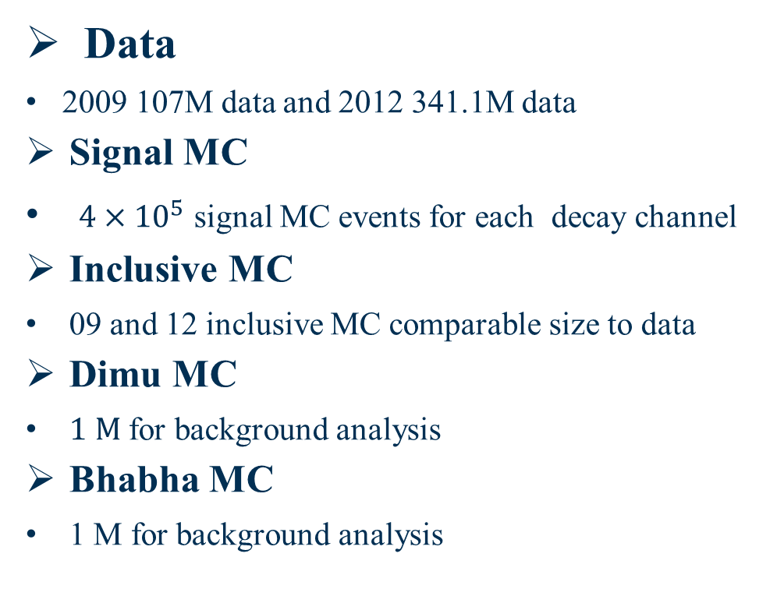
MC simulation and Data Sets
Boss Version
Boss 6.6.4p01 (for 2009 data)
Boss 6.6.4p03 (for 2012 data)
Generator
${ψ^{′}→γχ}_{c0}$ $, χ_{c0}→π^{+}π^{−}$/ $K^{+}K^{−}$ mDIY Add angular distribution of ${ χ}_{c0}$, dumpling factor,
E1 factor, Briet-Wigner of ${ψ^{′}→γχ}_{c0}$and then
divided by first order PHSP
${ψ^{′}→γχ}_{c2}, χ_{c2}→π^{+}π^{−}$/ $K^{+}K^{−}$ mDIY
the spiral amplitude parameters x and y：x=1.55,y=2.06($π^{+}π^{−}$) x=1.55,y=2.13($K^{+}K^{−}$) $.^{\left[2\right]}$
$χ_{c1}→π^{+}π^{−}\text{/}K^{+}K^{−}$ is forbidden due to P parity violation
Data
2009 107M data and 2012 341.1M data
Signal MC
${4×10}^{5}$ signal MC events for each decay channel
Inclusive MC
09 and 12 inclusive MC comparable size to data
Dimu MC
$1 M$ for background analysis
Bhabha MC
1 M for background analysis
[2]Phys.Rev.D 84 (2011) 092006

Slide 5
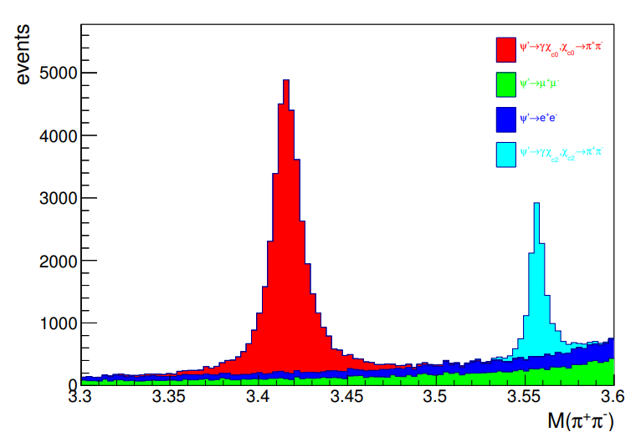
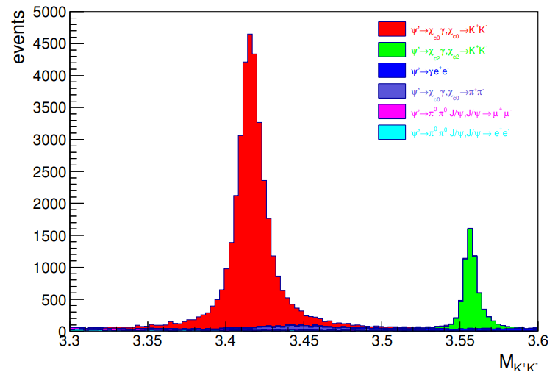
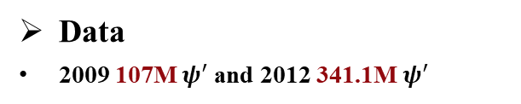
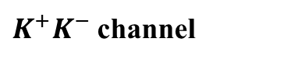
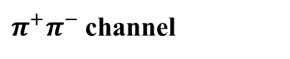
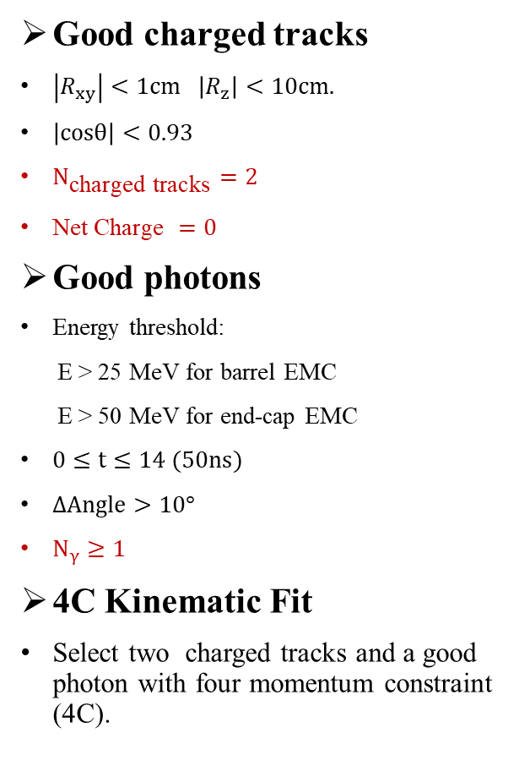
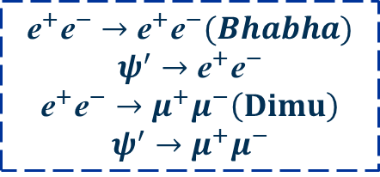
Initial Event selection
Good charged tracks
$\left|R_{xy}\right|<1cm \left|R_{z}\right|<10cm.$
$\left|cosθ\right|<0.93$
$N_{\text{charged} \text{tracks}}=2$
$\text{Net} \text{Charge} =0$
Good photons
Energy threshold:
E > 25 MeV for barrel EMC
E > 50 MeV for end-cap EMC
$0≤t≤14 (50ns)$
$ΔAngle>10°$
$N_{γ}≥1$
4C Kinematic Fit
Select two charged tracks and a good photon with four momentum constraint (4C).
Initial
Event
Selection
$$ψ(3686)$$
𝝍(𝟑𝟔𝟖𝟔)
$$χ_{cJ}$$
𝝌_𝒄𝑱
$$π^{+}/K^{+}$$
𝝅^+/𝑲^+
$$π^{−}{/K}^{−}$$
𝝅^− 〖/𝑲〗^−
$$γ$$
𝛾
$π^{+}π^{−}$ channel
Data
2009 107M $ψ^{′}$and 2012 341.1M $ψ^{′}$
Signal and background distribution for inclusive MC.
Main background
$K^{+}K^{−}$ channel
$${\text{e}}^{+}{\text{e}}^{−}→{\text{e}}^{+}{\text{e}}^{−}(Bhabha)$$
$$ψ^{′}→{\text{e}}^{+}{\text{e}}^{−}$$
$${\text{e}}^{+}{\text{e}}^{−}→μ^{+}μ^{−}\left(Dimu\right)$$
$$ψ^{′}→μ^{+}μ^{−}$$
5

Slide 6
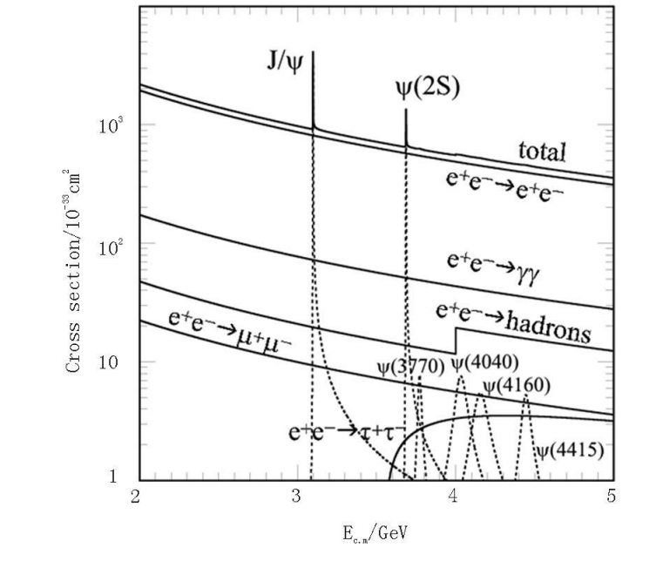
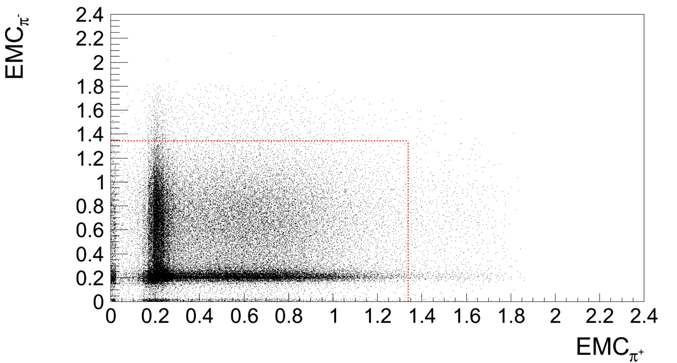
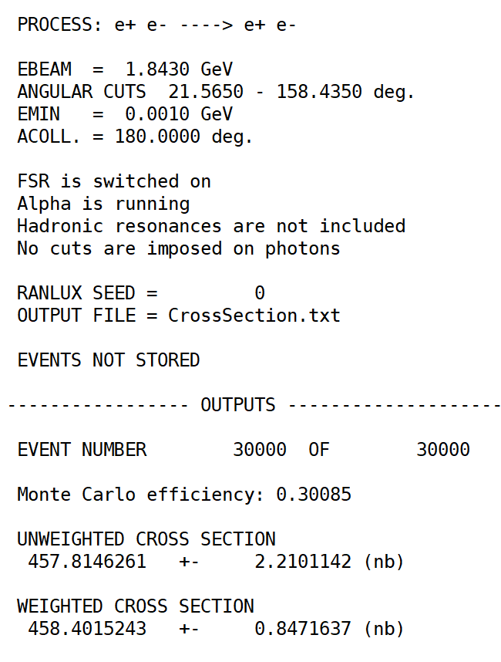
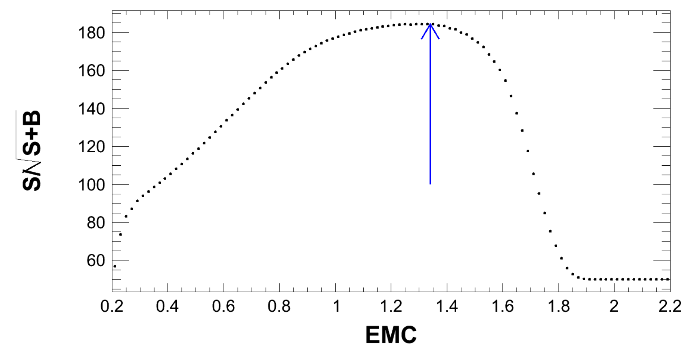
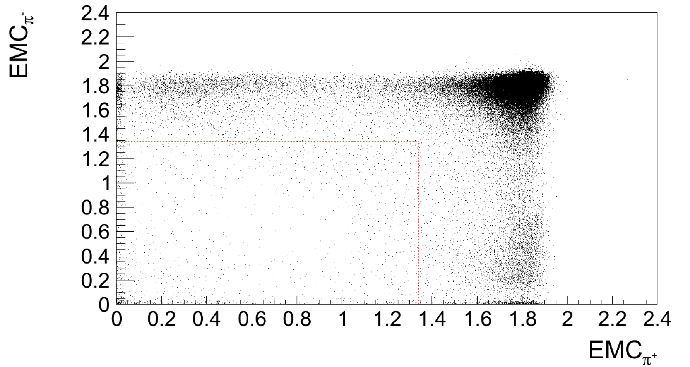

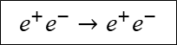

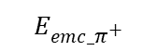

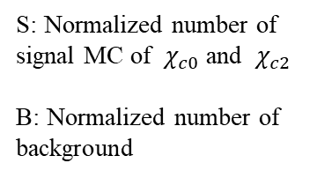
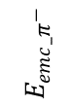
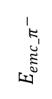
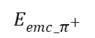
Background Study of $π^{+}π^{−}$
Background of Bhabha and $ψ^{′}→e^{+}e^{−}$
$$E_{emc_π^{−}}$$
Signal MC
$${\text{e}}^{+}{\text{e}}^{−}→{\text{e}}^{+}{\text{e}}^{−}$$
Red box for selecting signal events
$$E_{emc_π^{+}}$$
${\text{π}}^{+}$and ${\text{π}}^{−}$EMC deposited energy distribution
$$E_{emc_π^{−}}$$
Bhabha MC
S: Normalized number of signal MC of ${ χ}_{c0}$ and ${ χ}_{c2}$
B: Normalized number of background
($m_{χ_{cj}}$>3.3&& $m_{χ_{cj}}$<3.6)&&($χ_{4c}^{2}$ <60)
$$E_{emc}$$
$$E_{emc_π^{+}}$$
$E_{emc}$($π^{+}$)<1.34&& $E_{emc}$($π^{−}$)<1.34 for $e^{+}e^{−}$veto
The corresponding distribution of the electron sample

Slide 7
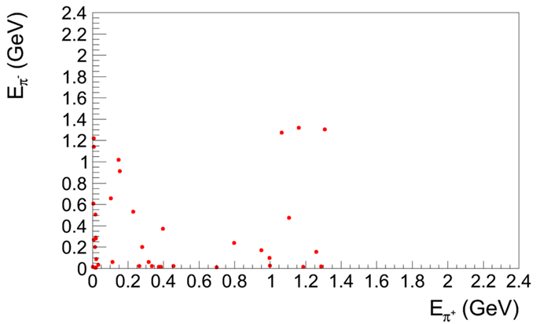
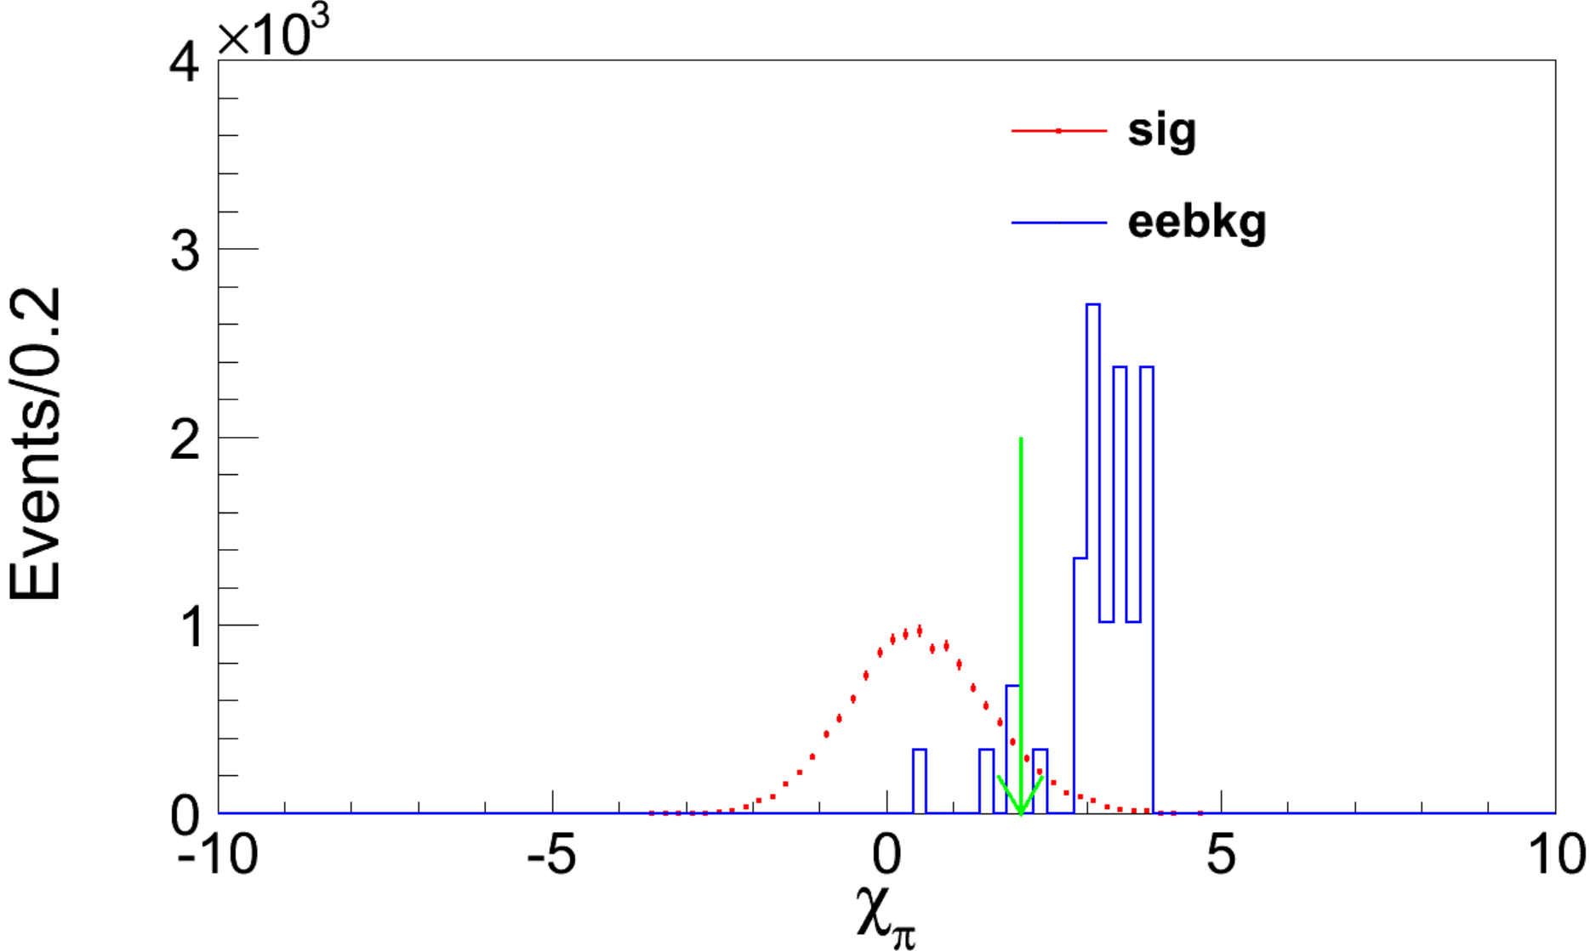
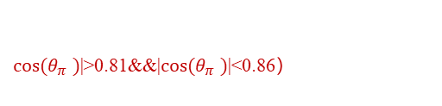

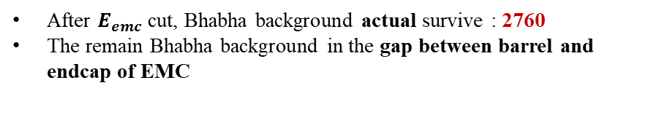
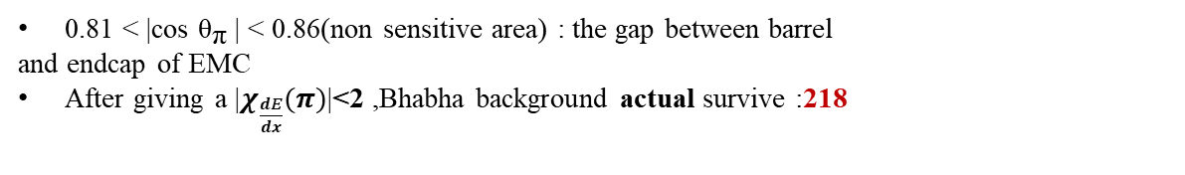
Background Study of $π^{+}π^{−}$
Background of Bhabha in the gap between barrel and endcap of EMC
$cos⁡(θ_{π}^{})$|>0.81&&|$cos⁡(θ_{π}^{})$|<0.86）
$cos⁡(θ_{π}^{})$|>0.81&&|$cos⁡(θ_{π}^{})$|<0.86）
The distribution of Bhabha background
| $χ_{dE/dx}^{π}$ |<2 in the gap between barrel and endcap of EMC
After $E_{emc}$ cut, Bhabha background actual survive : 2760
The remain Bhabha background in the gap between barrel and endcap of EMC
0.81 < |cos ${\text{θ}}_{\text{π}}$| < 0.86(non sensitive area) : the gap between barrel
and endcap of EMC
After giving a |$χ_{\frac{dE}{dx}}(π)$|<2 ,Bhabha background actual survive :218

Slide 8
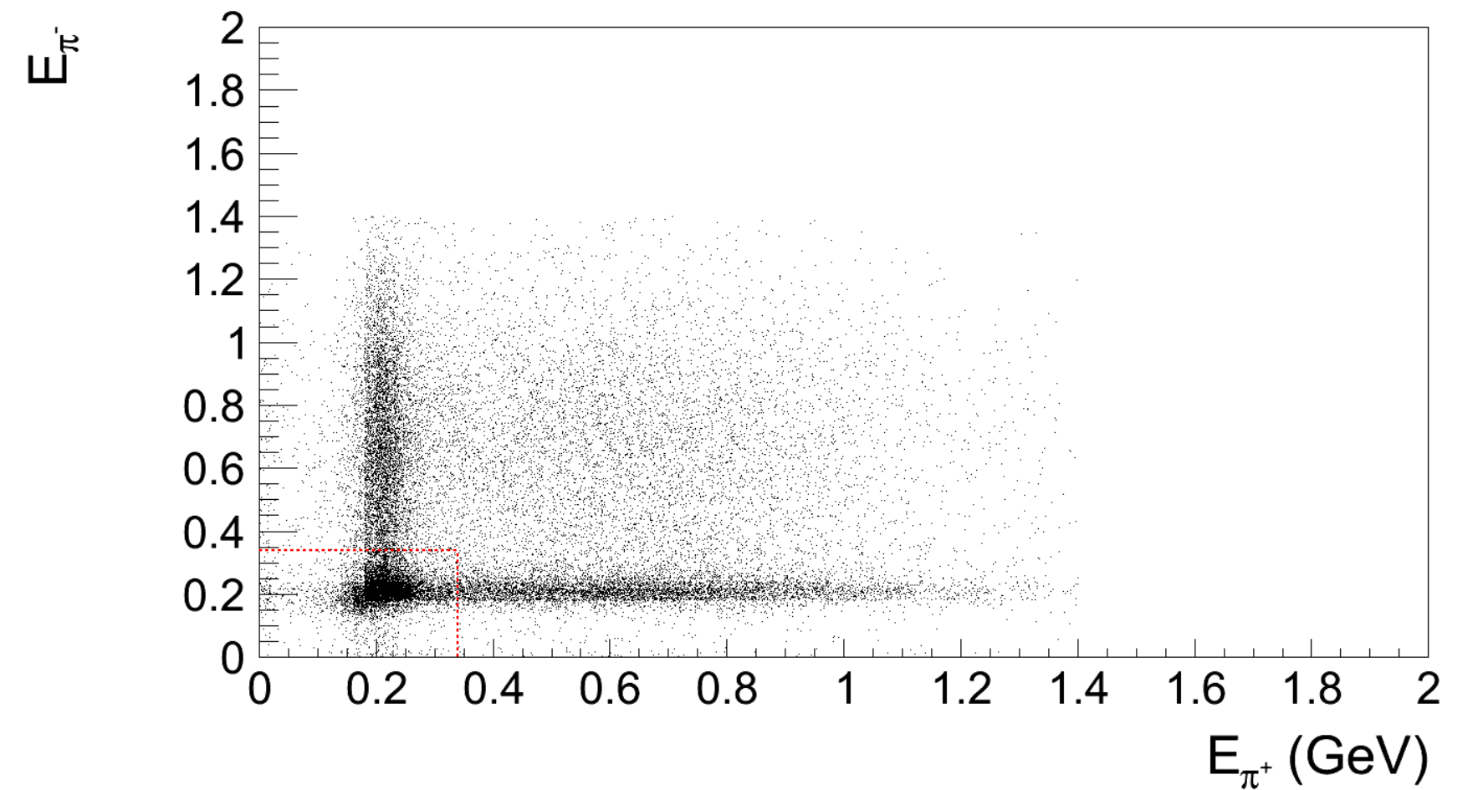
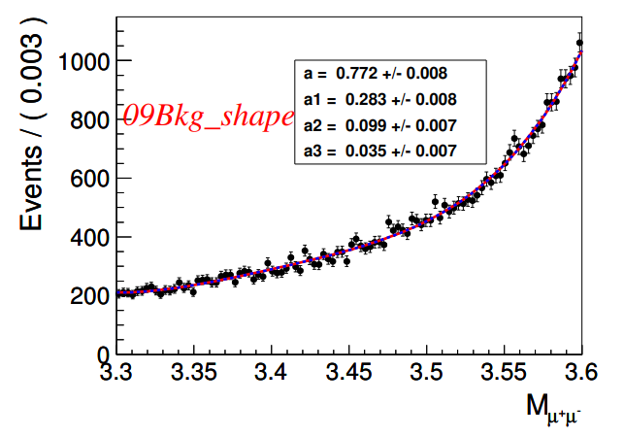
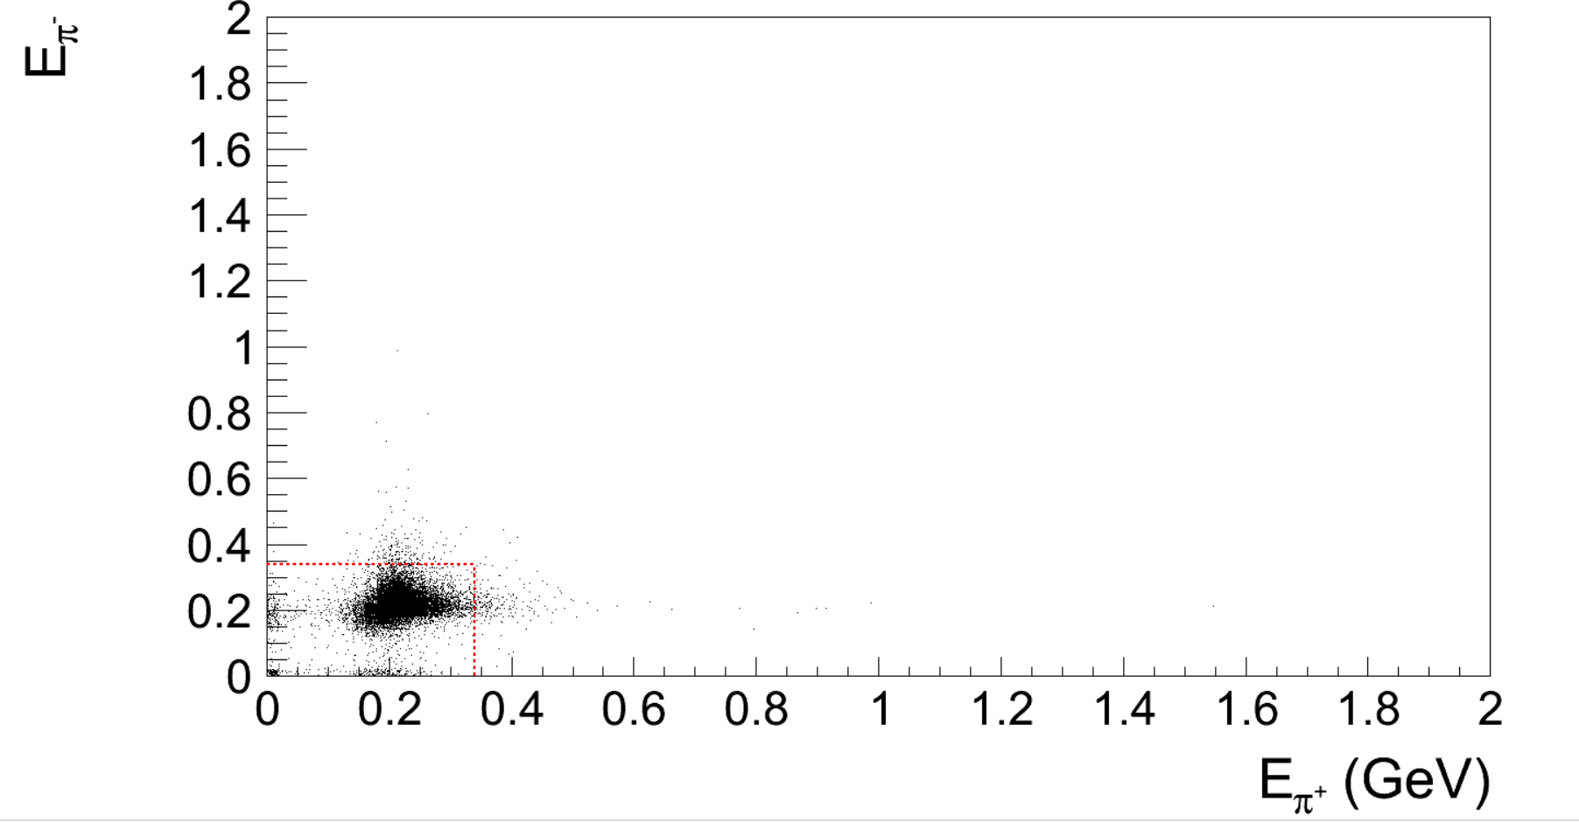
Background Study of $π^{+}π^{−}$
Background of ${\text{e}}^{+}{\text{e}}^{−}→μ^{+}μ^{−}\left(Dimu\right) and ψ^{′}→μ^{+}μ^{−}$
Signal MC
loss of signal:27%
Dimu MC
$E_{emc}$ ($π^{+} )$>0.34|| $E_{emc}$ ($π^{−}$)>0.34
Fit dimu and $ψ^{′}→μ^{+}μ^{−}$ and with forth polynomial
Do not use this cut

Slide 9
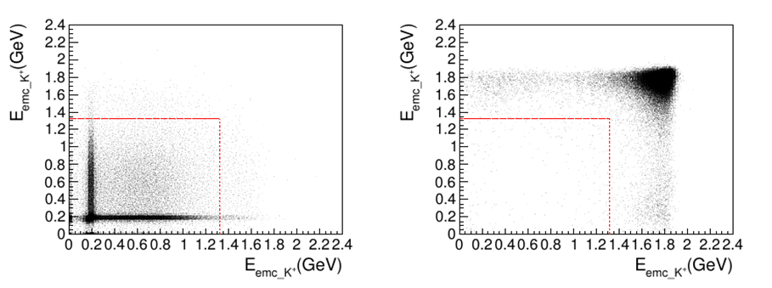
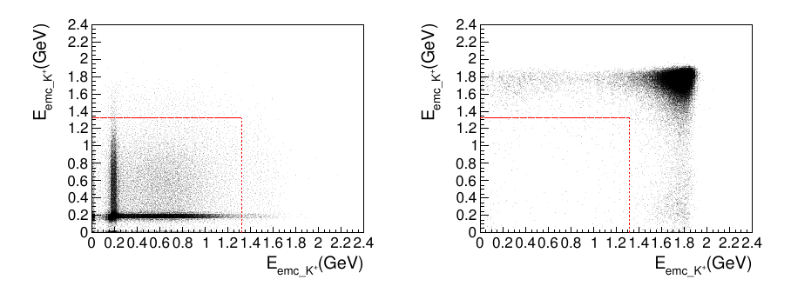
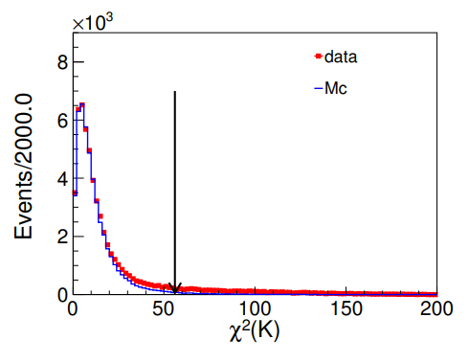

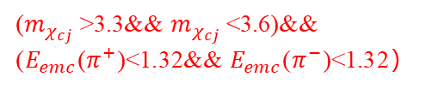

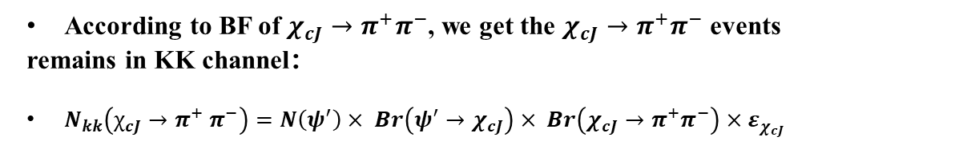
Background Study of $K^{+}K^{−}$
Background of Bhabha and $ψ^{′}→e^{+}e^{−}$/ $e^{+}e^{−}$ $π^{0}π^{0}$
peaking background: $χ_{cJ}→π^{+}π^{−}$
According to BF of $χ_{cJ}→π^{+}π^{−}$, we get the $χ_{cJ}→π^{+}π^{−}$ events
remains in KK channel：
$N_{kk}\left(χ_{cJ}→π^{+} π^{−}\right)=N\left(ψ^{′}\right)× Br\left(ψ^{′}→χ_{cJ}\right)× Br\left(χ_{cJ}→π^{+}π^{−}\right)×ε_{χ_{cJ}}$
Signal MC
Kinematic Fit
Bhabha MC
($m_{χ_{cj}}$>3.3&& $m_{χ_{cj}}$<3.6)&& ($E_{emc}$($π^{+}$)<1.32&& $E_{emc}$($π^{−}$)<1.32）
$${χ^{2}}_{4C}<56$$
$E_{emc}$($K^{+}$)<1.34&& $E_{emc}$($K^{−}$)<1.34 for $e^{+}e^{−}$veto
$χ^{2}$ distribution of data, signal MC, and inclusive MC.

Slide 10
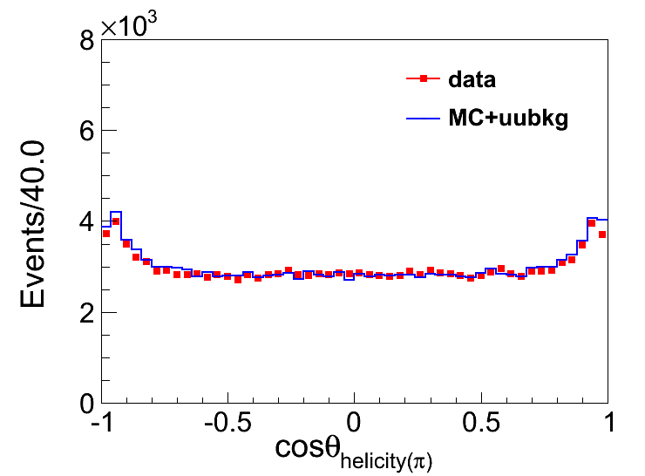
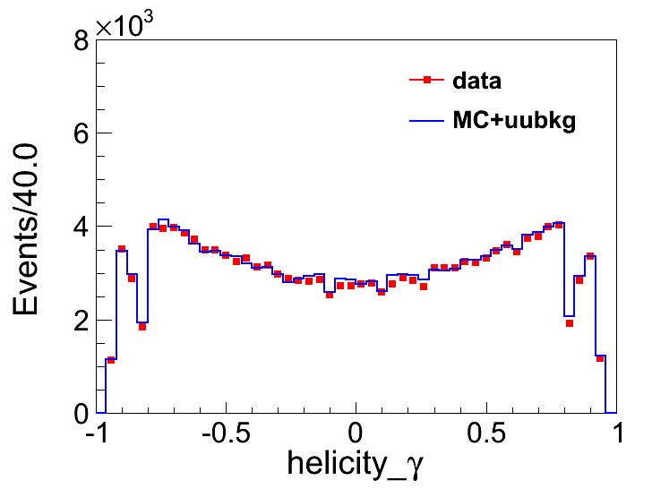
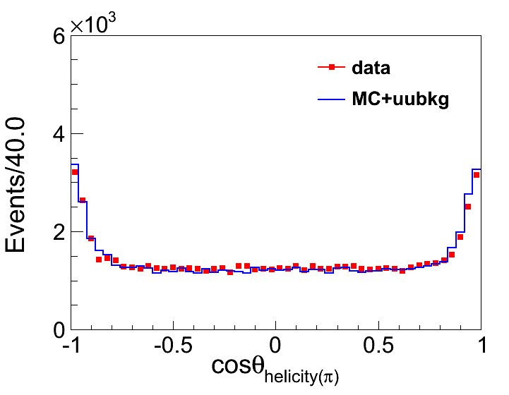
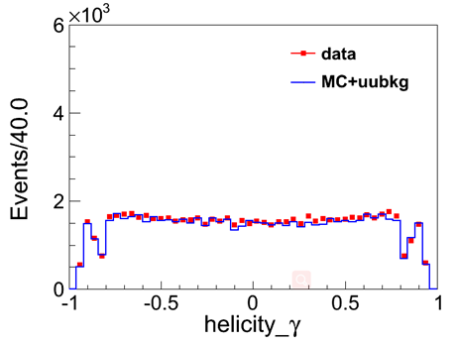
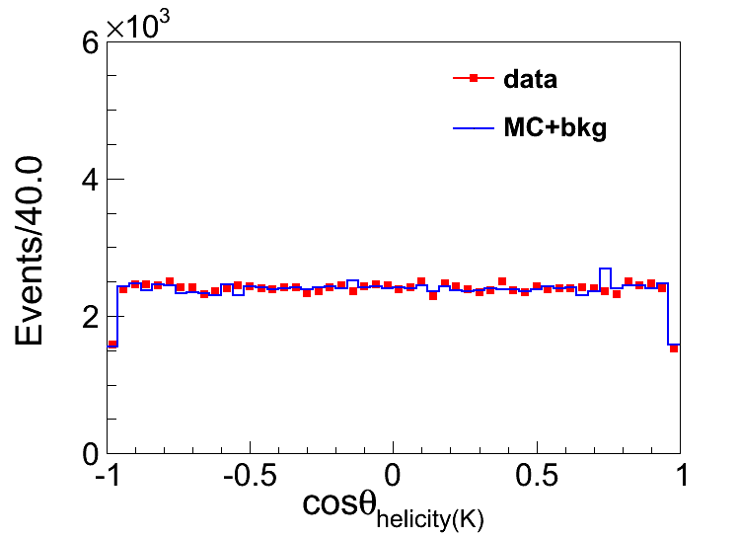
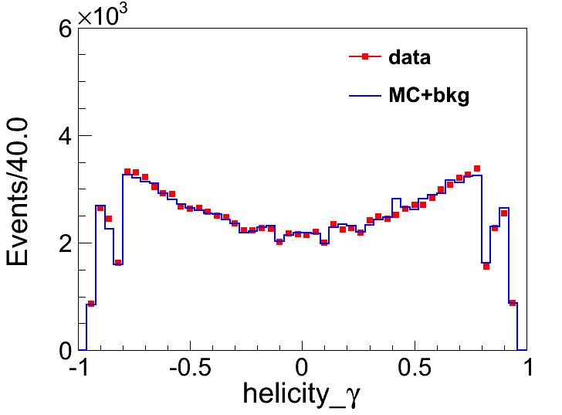
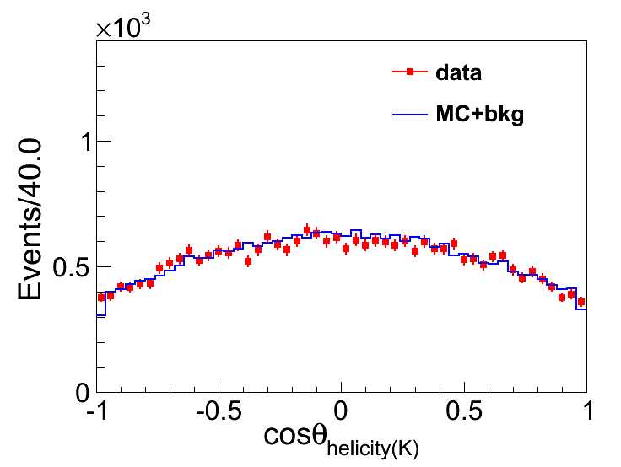
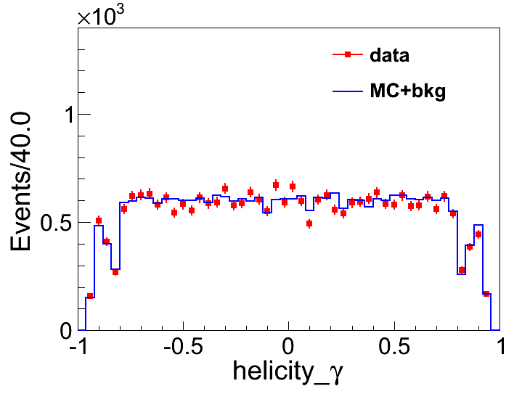
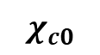
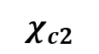
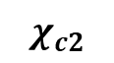
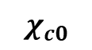




Background Study
$$χ_{c0}$$
$$χ_{c0}$$
$$χ_{c2}$$
$$χ_{c2}$$
The helicity angle of $π^{+}{(π}^{−}$) between data and MC
$$χ_{c0}$$
$$χ_{c0}$$
$$χ_{c2}$$
$$χ_{c2}$$
The helicity angle of $K^{+}{(K}^{−}$) between data and MC
Notes:
这页想说什么？

Slide 11






Fitting Result
Simultaneous Fit
Signal Shape
$χ_{c0}:$ $\left(BW×PS^{2}\left(\sqrt{s} \right)×D^{2}\left(\sqrt{s}\right)×PHSP(χ_{c0}→π^{+}π^{−}\text{/ }K^{+}K^{−})×Eff Curve\right)⊗ Resolution$
$χ_{c2}\text{: }BW ⊗ Resolution$
Fix the width and mass of $χ_{c2}$
Background Shape
$K^{+}K^{−}$ channel ：Fix events of $χ_{cJ}→π^{+}π^{−}$
Add a second order polynomial
${ π}^{+}π^{−}$ channel：Forth order polynomial for dimu and ${ψ^{′}→u}^{+}u^{−}$ background
Add a second order polynomial for other background
Get the mass split of $χ_{c2}$ and $χ_{c0}$，BF of $χ_{cJ}→π^{+}π^{−}$/ $K^{+}K^{−}$ and width of $χ_{c0}$ simultaneously.
E1 factor :
Dumpping factor：
Two body decay:

Slide 12









Fitting Result
Efficiency Curve
Resolution
Total Resolution: $G=G_{1}⊗G_{2}$
Detector Resolution: $G_{1}$
09
$09π^{+}$ $π^{−}$
${09K}^{+}$ $K^{−}$
09 data
Difference between MC and data: $G_{2}$
For this part, we add additional Gaussian function in the fit with parameters kept float as the difference between data and MC. The second part of resolution for $χ_{c2}$and $χ_{c0}$are assumed to be the same.
09
PHSP of $χ_{c0}→π^{+}π^{−}$/ $K^{+}K^{−}$:$\frac{{|P}_{1}|}{M^{2}}$

Slide 13


Systematic Uncertainties
$ψ^{′}$total number
448.1±2.9M
2.9/448.1=0.647% $.^{[3]}$
Intermediate branching fraction
$Br(ψ^{′}→γχ_{c0})=9.79±0.2\%$
$Br(ψ^{′}→γχ_{c2})=9.52±0.2\%$
${ χ}_{c0} :$ 2.04% ${ χ}_{c2} :$2.10%
Photon detection
the uncertainty of each photon detection
efficiency is 1%
Background shape
Polynomial Background
Fitting the background from second order
polynomial to first order polynomial
Dimu Background
Vary the $σ$of the output cross-section of
Babayaga within the statistical uncertainty.
Vary the σ of the fixed parameters with in
one time of the statistical uncertainty
Cross Contamination Background
Background from ${ χ}_{cJ}→K^{+}K^{−} r$esidue in $π^{+}π^{−}$Mode
Background from ${ χ}_{cJ}→π^{+}π^{−} r$esidue in $K^{+}K^{−}$Mode
Signal model
Dumpling factor
Change the dumpling factor from $D(\sqrt{s})={\left(\frac{{\left(E_{γ}^{0}\right)}^{2}}{E_{γ}^{0}E_{γ}^{ }+{\left(E_{γ}^{0}−E_{γ}^{ }\right)}^{2}}\right)}^{\frac{1}{2}}$
to $D\left(\sqrt{s}\right)=exp⁡(−\frac{E_{γ}^{2}}{8β^{2}}).^{[3]}$
Efficiency Curve
Consider the correlation coefficient of the two parameters of the efficiency curve, and use the 2D Gaussian function for sampling to obtain several sets of correlated parameters, which are put into the simultaneous fitting.
Breit-Wigner
Change the relativistic BW form into DIY BW and take the result difference as the systematic uncertainty.
[3]:doi:10.1088/1674-1137/37/6/063001

Slide 14


Systematic Uncertainties
Fitting range
Take a Barlow test to estimate the effect of fitting range.
$π^{+}π^{−}$ channel: transformed the fitting range of $π^{+}π^{−}$
from 3.3∼3.6 to 3.29∼3.6, 3.295∼3.6, 3.3∼3.605, 3.3∼3.61
respectively, resulting error was within 1 $σ$.
$K^{+}K^{−}$ channel: same as above, resulting error was within 1 $σ$.
Tracking detection
Using kaon tracking corrected parameters(from
$J/ψ →K_{S}^{0}K^{±}π^{∓}→Kπππ$study) and pion parameters
(from $e^{+}e^{−}→π^{+}π^{−}J/ψ$ study), get the systematic
uncertainties of tracking detection.
EMC deposited energy for charged particle selection
Take a Barlow test to estimate the effect of $E_{emc}$requirement.
$π^{+}π^{−}$ channel: transformed the $E_{emc}$ requirement from
1.32 to 1.28, 1.29, 1.30, 1.31, 1.33, 1.34 and 1.35,
resulting error was within 1 $σ$.
$K^{+}K^{−}$ channel, same as above, resulting error was within 1 $σ$.
Detector resolution
Vary the $σ$of the smeared gaussian within the statistical uncertainty.
$χ_{c2}$Mass
The mass of $χ_{c2}$in PDG is $3556.2MeV$, while the value from LHCb is $3556.1MeV$. We use the resolution of MC which the mass results get from PDG. The resultant changes on the final results are taken as systematic uncertainties.
Spiral Amplitude Parameter
Consider the correlation coefficient of the two parameters of the input values, and used the
2D Gaussian function for sampling to obtain several sets of correlated parameters.

Slide 15





Systematic Uncertainties
Kinematic Fitting
 | $$φ$$ |  | $$k$$ |  | $$\tan{λ}$$
 | $M_{data}$-$M_{mc}$ | $σ_{data}$/$σ_{mc}$ | $M_{data}$-$M_{mc}$ | $σ_{data}$/$σ_{mc}$ | $M_{data}$-$M_{mc}$ | $σ_{data}$/$σ_{mc}$
$π^{+}$ | 0.0354811 | 1.084835 | -0.0417118 | 1.135015 | 0.776444 | 1.092635
$π^{−}$ | 0.0576503 | 1.075595 | -0.11047245 | 1.106025 | 0.740545 | 1.102225
$K^{+}$ | 0.0279838 | 1.151865 | -0.0866352 | 1.23151 | 0.699859 | 1.190615
$K^{−}$ | 0.04215445 | 1.16965 | -0.01293738 | 1.239595 | 0.664687 | 1.171655
We can see, it shows good agreement between MC and data.

Slide 16


















Systematic Uncertainties
The $χ^{2}$ distribution of MC become consistent with data after correction.
$${ χ}_{c0}$$
$${ χ}_{c0}$$
$${ χ}_{c0}$$
$${ χ}_{c0}$$
$K^{+}$ $K^{−}$channel
$π^{+}$ $π^{−}$channel
$${ χ}_{c2}$$
$${ χ}_{c2}$$
$${ χ}_{c2}$$
$${ χ}_{c2}$$
Get the systematic uncertainties of kinematic fitting for $K^{+}$ $K^{−}/π^{+}$ $π^{−}$ by using half of the difference of MC efficiency with or without helix parameter correction.

Slide 17



Systematic Uncertainties
Systematic Uncertainties of ${ χ}_{c0}/{ χ}_{c2}→{π^{+}π^{−}/K}^{+}K^{−}$
Systematic Uncertainties of mass split and width of${ χ}_{c0}$
$$M_{χ_{c2}}−M_{χ_{c0}}=140.37±0.03±0.06MeV/c^{2}$$
$$Γ_{χ_{c0}}=12.33± 0.06±0.17MeV/c^{2}$$
$Br\left(χ_{c0}→π^{+}π^{−}\right)$ $=6. 11±0.02±0.08±0.12×{10}^{−3}$
$Br\left(χ_{c2}→π^{+}π^{−}\right)=$ $1. 64±0.01±0.02±0.03×{10}^{−3}$
$Br(χ_{c0}→K^{+}K^{−})$= $6.43±0.02±0.09±0.13×{10}^{−3}$
$Br(χ_{c2}→K^{+}K^{−})$= $1.23±0.01±0.02±0.03×{10}^{−3}$

Slide 18



Summary
The branch fraction of ${ χ}_{cJ}→π^{+}π^{−}$/ $K^{+}K^{−}$ are measured:
The mass split of $χ_{c2}$ and $χ_{c0}$ are measured:
We get the width of $χ_{c0}$ :
$Br\left(χ_{c0}→π^{+}π^{−}\right)$ $=6. 11±0.02±0.08±0.12×{10}^{−3}$
$Br\left(χ_{c2}→π^{+}π^{−}\right)=$ $1. 64±0.01±0.02±0.03×{10}^{−3}$
$Br(χ_{c0}→K^{+}K^{−})$= $6.43±0.02±0.09±0.13×{10}^{−3}$
$Br(χ_{c2}→K^{+}K^{−})$= $1.23±0.01±0.02±0.03×{10}^{−3}$
$$M_{χ_{c2}}−M_{χ_{c0}}=140.37±0.03±0.06MeV/c^{2}$$
$$Γ_{χ_{c0}}=12.33± 0.06±0.17MeV/c^{2}$$

Slide 19

Thank you for your listening.

Slide 20
Backups

Slide 21

Fitting Result

Slide 22




Fitting Result

Slide 23

Background Study--optimization
Calculate the normalization factor
$u^{+}u^{−}$and $e^{+}e^{−}$ normalization factor ：
Signal normalization factor:
$$\begin{matrix}S_{χ_{c0}}=\frac{N_{χ_{c0}signal}}{400000}=0.148574 \\ S_{χ_{c2}}=\frac{N_{χ_{c2}signal}}{400000}=0.037859 \\ \end{matrix}$$

Slide 24





Systematic Uncertainties
Detailed kinematic fitting correction process
$K^{+}$ $K^{−}$ sample:
After the above selection conditions, the background was very low, so we selected the MC and data after events selection as sample.
The background level of each signal interval is about 2%
$π^{+}$ $π^{−}$ sample:
In addition to the original selection conditions, we added a condition to remove the $u^{+}$ $u^{−}$ background by means of deposition energy, so that we could obtain a clean sample as our sample.
The background level of each signal interval is about 2%

Slide 25





















Systematic Uncertainties
Kinematic Fitting
Choose clear $π^{+}$ $π^{−}$and $K^{+}K^{−}$sample with 98% purity.
Get the correction factors by comparing the difference between MC and data.
It was overcorrection for tan$λ \text{a}\text{fter} \text{correction}\text{.}$
$${ χ}_{c0}$$
$${ χ}_{c0}$$
$${ χ}_{c2}$$
$${ χ}_{c2}$$
$K^{+}$ $K^{−}$
channel
$${ χ}_{c0}$$
$${ χ}_{c0}$$
$${ χ}_{c2}$$
$${ χ}_{c2}$$
$${ χ}_{c0}$$
$${ χ}_{c0}$$
$${ χ}_{c2}$$
$${ χ}_{c2}$$
Overcorrection

Slide 26













Systematic Uncertainties
Overcorrection is strange, and we look for possible causes.
$α_{0}$is the unconstrained track parameters obtained from the reconstruction, $α$is the constrained track
parameters obtained from kinematic fitting and V is the corresponding covariance matrix.
Since the definition of pull is this formula, we have only modified $V_{α0}$, the presence of $V_{α}$is not considered.
So we compare the diagonal elements of the error matrix before and after kinematic fitting.
If the error after kinematic fitting($V_{α}$) is not negligible, we speculate that it will lead to overcorrection.
The following five error matrix correspond to five pull parameters respectively:$dρ,φ_{0}\text{, }κ, \text{dz}\text{, }\text{tan}λ.$
almost zero
cannot be neglected
Take $K^{+}K^{−}$channel for example

Slide 27


















Systematic Uncertainties
Comparison of the pull distribution from 4C kinematic fitting for each charged track
$${ χ}_{c0}$$
$${ χ}_{c0}$$
$K^{+}$ $K^{−}$channel
$${ χ}_{c0}$$
$${ χ}_{c0}$$
$${ χ}_{c0}$$
$${ χ}_{c0}$$
The difference between MC and data shows that track parameters in MC simulation disagree with that in data.

Slide 28













Systematic Uncertainties
$π^{+}$ $π^{−}$channel

Slide 29






Systematic Uncertainties
Correction Method
(For briefly, we take the parameter $\tan{λ}$ from $χ_{C0} K^{+}$ as an example, the same steps for other parameters)
We use double gauss to fit the MC and data. the two gauss use the same mean, the total sigma is the average of two sigma.
The reason why we don’t use single gauss is that it can’t describe the shape well, show in figure.
Then , we can get the difference of mean and sigma between MC and data.
Double gauss fit MC
Double gauss fit data
Single gauss fit data
Single gauss fit MC
the difference of mean and sigma between MC and data

Slide 30











Systematic Uncertainties
Before cor

Slide 31













Systematic Uncertainties
Fit data for $χ_{c0}$

Slide 32













Systematic Uncertainties
Fit data for $χ_{c2}$

Slide 33
















Systematic Uncertainties
0.94362/1.30278=x/0.94362 x=0.683738 0.935196/1.34967=x/0.935196 x=0.648004
After cor

Slide 34


Systematic Uncertainties
The correction factors
 | $$φ$$ |  | $$k$$ |  | $$\tan{λ}$$
 | $M_{data}$-$M_{mc}$ | $σ_{data}$/$σ_{mc}$ | $M_{data}$-$M_{mc}$ | $σ_{data}$/$σ_{mc}$ | $M_{data}$-$M_{mc}$ | $σ_{data}$/$σ_{mc}$
$χ_{C0} π^{+}$ | 0.0270848 | 1.10642 | -0.0377213 | 1.12551 | 0.987865 | 1.09474
$χ_{C0} π^{−}$ | 0.0593689 | 1.10084 | -0.0993279 | 1.10627 | 0.974777 | 1.09914
$χ_{C2} π^{+}$ | 0.0438774 | 1.06325 | -0.0457023 | 1.14452 | 1.12046 | 1.09053
$χ_{C2} π^{−}$ | 0.0559317 | 1.05035 | -0.121617 | 1.10578 | 1.0922 | 1.10531
$χ_{C0} K^{+}$ | 0.0197858 | 1.15259 | -0.0744335 | 1.18414 | 0.94362 | 1.1586
$χ_{C0} K^{−}$ | 0.0382306 | 1.15735 | -0.0355562 | 1.19471 | 0.935196 | 1.14144
$χ_{C2} K^{+}$ | 0.0361818 | 1.15114 | -0.0988369 | 1.27888 | 1.03321 | 1.22263
$χ_{C2} K^{−}$ | 0.0460783 | 1.18195 | 0.00968145 | 1.28448 | 1.02867 | 1.20187
By comparing the difference between MC and data, we get the correction factors

Slide 35


Systematic Uncertainties
We adopt these corrections in the MC simulation, then we compare the distribution of pull.
$K^{+}$ $K^{−}$
channel
We found that it was overcorrection

Slide 36




















Systematic Uncertainties
$π^{+}$ $π^{−}$channel
$${ χ}_{c0}$$
$${ χ}_{c0}$$
$${ χ}_{c2}$$
$${ χ}_{c2}$$
$${ χ}_{c0}$$
$${ χ}_{c0}$$
$${ χ}_{c2}$$
$${ χ}_{c2}$$
The same overcorrection
$${ χ}_{c0}$$
$${ χ}_{c0}$$
$${ χ}_{c2}$$
$${ χ}_{c2}$$

Slide 37

Systematic Uncertainties
Overcorrection is strange, and we look for possible causes.
$α_{0}$is the unconstrained track parameters obtained from the reconstruction, $α$is the constrained track
parameters obtained from kinematic fitting and V is the corresponding covariance matrix.
Since the definition of pull is this formula, we have only modified $V_{α0}$, the presence of $V_{α}$is not considered.
So we compare the diagonal elements of the error matrix before and after kinematic fitting.
If the error after kinematic fitting($V_{α}$) is not negligible, we speculate that it will lead to overcorrection.
almost zero
cannot be neglected
Take $K^{+}$ $K^{−}$channel for example

Slide 38





Systematic Uncertainties
Due to the previous excessive correction for tan$λ$, we adjust the mean value of tan$λ$ in proportion.
Take $χ_{C0} K^{+}$ tan$λ$ for example, we fit the corrected MC again and found that it overcorrected to 1.3. To get it to 0.9, we need to scale the correction parameter to 0.68:
$\frac{0.94362}{1.30278}=\frac{x}{0.94362}$ $x=0.683738$
The same method for other tracks.

Slide 39


Systematic Uncertainties
 | $$φ$$ |  | $$k$$ |  | $$\tan{λ}$$
 | $M_{data}$-$M_{mc}$ | $σ_{data}$/$σ_{mc}$ | $M_{data}$-$M_{mc}$ | $σ_{data}$/$σ_{mc}$ | $M_{data}$-$M_{mc}$ | $σ_{data}$/$σ_{mc}$
$χ_{C0} π^{+}$ | 0.0270848 | 1.10642 | -0.0377213 | 1.12551 | 0.73467 | 1.09474
$χ_{C0} π^{−}$ | 0.0593689 | 1.10084 | -0.0993279 | 1.10627 | 0.72445 | 1.09914
$χ_{C2} π^{+}$ | 0.0438774 | 1.06325 | -0.0457023 | 1.14452 | 0.818218 | 1.09053
$χ_{C2} π^{−}$ | 0.0559317 | 1.05035 | -0.121617 | 1.10578 | 0.75664 | 1.10531
$χ_{C0} K^{+}$ | 0.0197858 | 1.15259 | -0.0744335 | 1.18414 | 0.683738 | 1.1586
$χ_{C0} K^{−}$ | 0.0382306 | 1.15735 | -0.0355562 | 1.19471 | 0.648004 | 1.14144
$χ_{C2} K^{+}$ | 0.0361818 | 1.15114 | -0.0988369 | 1.27888 | 0.71598 | 1.22263
$χ_{C2} K^{−}$ | 0.0460783 | 1.18195 | 0.00968145 | 1.28448 | 0.68137 | 1.20187
We further adjusted the mean value of tan$λ$

Slide 40

























Systematic Uncertainties
Now we see that MC and data are in good agreement
$K^{+}$ $K^{−}$channel
$${ χ}_{c0}$$
$${ χ}_{c0}$$
$${ χ}_{c2}$$
$${ χ}_{c2}$$
$${ χ}_{c0}$$
$${ χ}_{c0}$$
$${ χ}_{c2}$$
$${ χ}_{c2}$$
$${ χ}_{c0}$$
$${ χ}_{c0}$$
$${ χ}_{c2}$$
$${ χ}_{c2}$$

Slide 41
























Systematic Uncertainties
$π^{+}$ $π^{−}$channel
$${ χ}_{c0}$$
$${ χ}_{c0}$$
$${ χ}_{c2}$$
$${ χ}_{c2}$$
$${ χ}_{c0}$$
$${ χ}_{c0}$$
$${ χ}_{c2}$$
$${ χ}_{c2}$$
$${ χ}_{c0}$$
$${ χ}_{c0}$$
$${ χ}_{c2}$$
$${ χ}_{c2}$$

Slide 42


Systematic Uncertainties
Final correction parameters
 | $$φ$$ |  | $$k$$ |  | $$\tan{λ}$$
 | $M_{data}$-$M_{mc}$ | $σ_{data}$/$σ_{mc}$ | $M_{data}$-$M_{mc}$ | $σ_{data}$/$σ_{mc}$ | $M_{data}$-$M_{mc}$ | $σ_{data}$/$σ_{mc}$
$π^{+}$ | 0.0354811 | 1.084835 | -0.0417118 | 1.135015 | 0.776444 | 1.092635
$π^{−}$ | 0.0576503 | 1.075595 | -0.11047245 | 1.106025 | 0.740545 | 1.102225
$K^{+}$ | 0.0279838 | 1.151865 | -0.0866352 | 1.23151 | 0.699859 | 1.190615
$K^{−}$ | 0.04215445 | 1.16965 | -0.01293738 | 1.239595 | 0.664687 | 1.171655
We took the average value of ${ χ}_{c0}$and ${ χ}_{c2}$ respectively, in this way, the same set of correction parameters can be used together for ${ χ}_{c0}$and ${ χ}_{c2}$.
We can see in next page, it shows good agreement between MC and data, too.

Slide 43









Systematic Uncertainties
$K^{+}$ $K^{−}$channel

Slide 44













Systematic Uncertainties
$π^{+}$ $π^{−}$channel

Slide 45











Systematic Uncertainties
We can see the $χ^{2}$ distribution of MC become consistent with data after correction.
$${ χ}_{c0}$$
$${ χ}_{c0}$$
$${ χ}_{c0}$$
$${ χ}_{c0}$$
$π^{+}$ $π^{−}$channel
$K^{+}$ $K^{−}$channel
$${ χ}_{c2}$$
$${ χ}_{c2}$$
$${ χ}_{c2}$$
$${ χ}_{c2}$$
We get the systematic uncertainties of kinematic fitting for $K^{+}$ $K^{−}/π^{+}$ $π^{−}$ by using half of the difference of MC efficiency with or without helix parameter correction:
$χ_{c0}$ 0.611% $χ_{c2}$ 0.667% $χ_{c0}$0.228% $χ_{c2}$ 0.294%

Slide 46











Systematic Uncertainties
Shows good agreement between MC and data.
The comparison of diagonal terms of the error matrix from MdcKalTrk for two tracks.

Slide 47

Tracking parameter correction
Kk 参数

Slide 48




K+
chic0
K-

Slide 49







K-
K+

